Slide 1
Inventions in our life

Slide 2
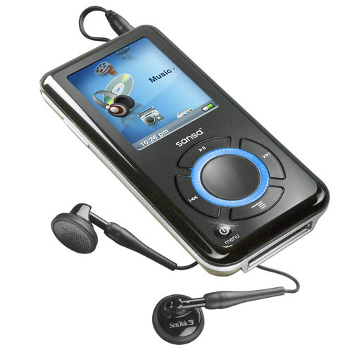
MP3 PLAYER

Slide 3
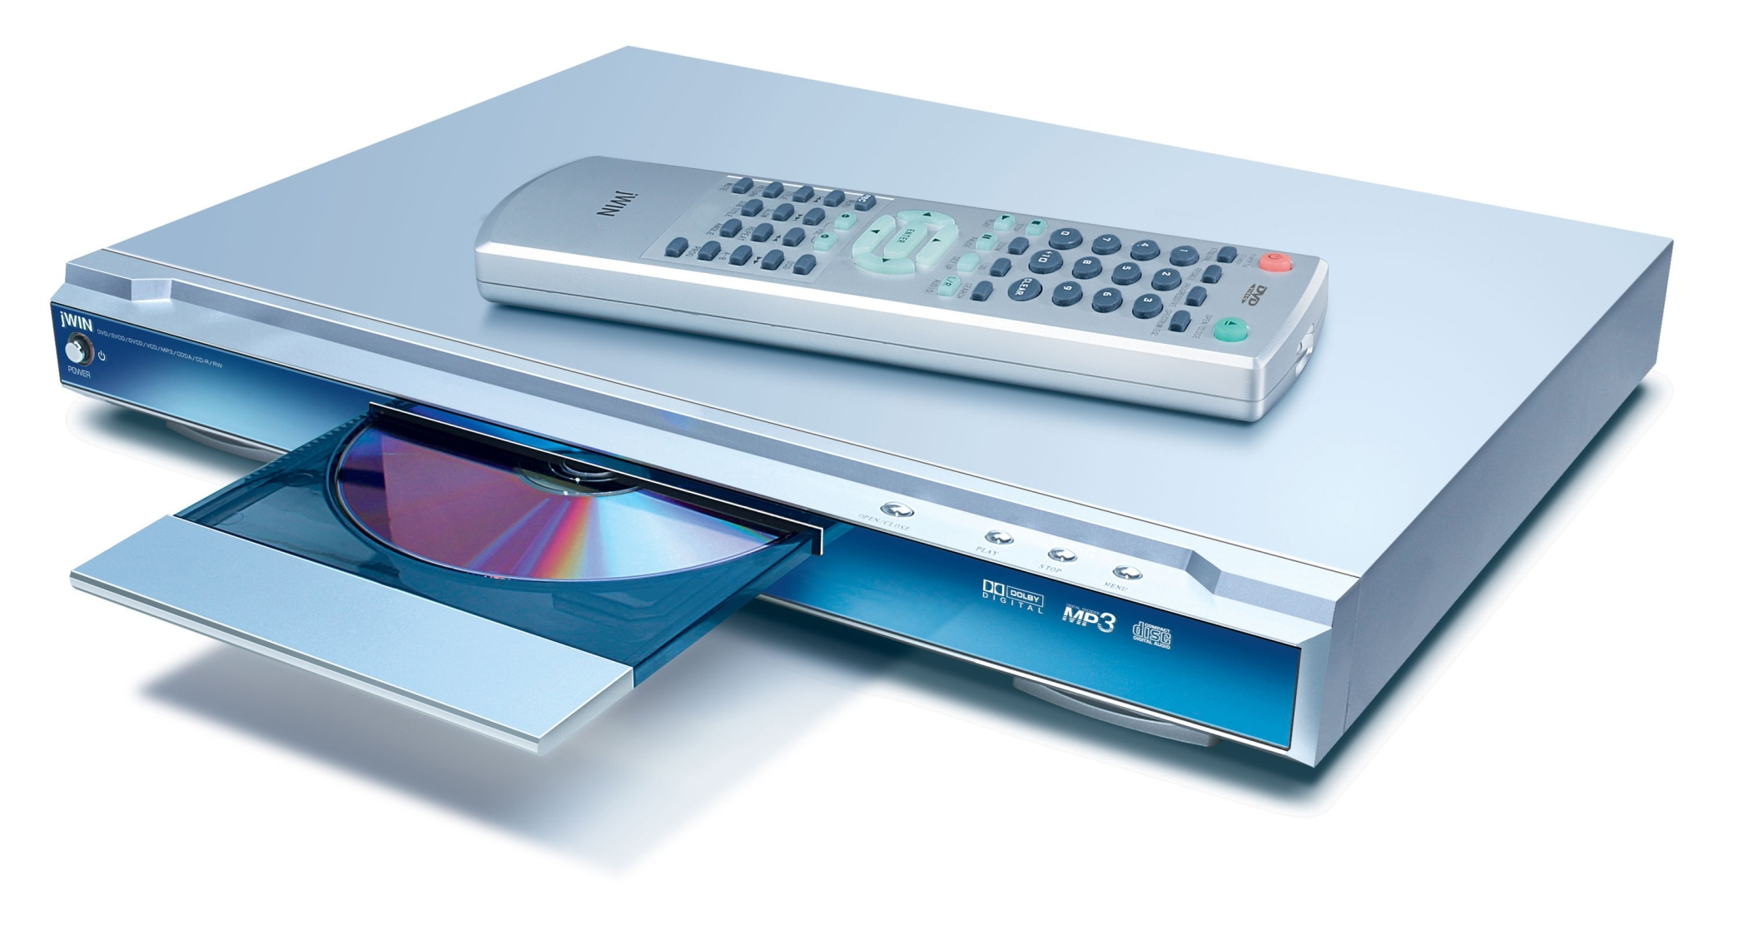
DVD - PLAYER

Slide 4
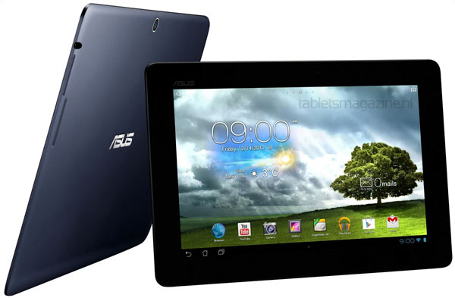
MEMO PAD

Slide 5
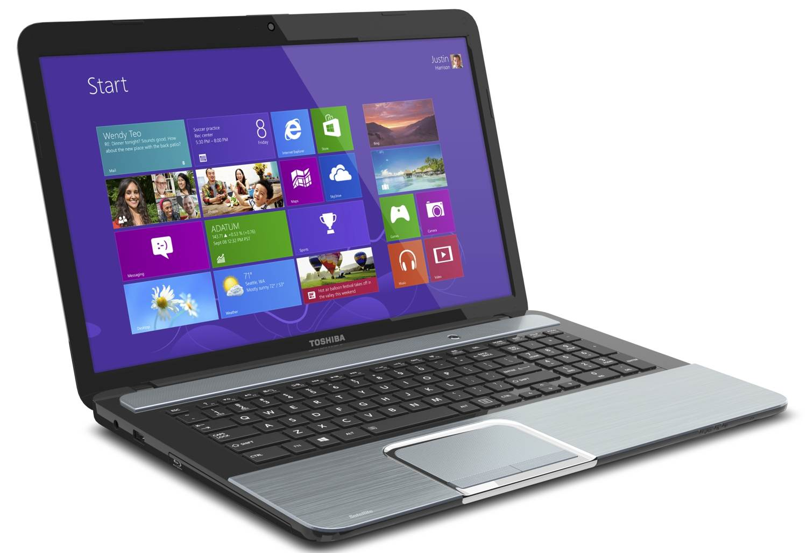
LAPTOP

Slide 6
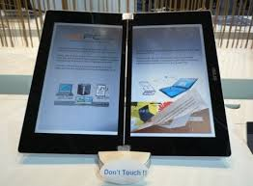
E-BOOK DEVICE

Slide 7
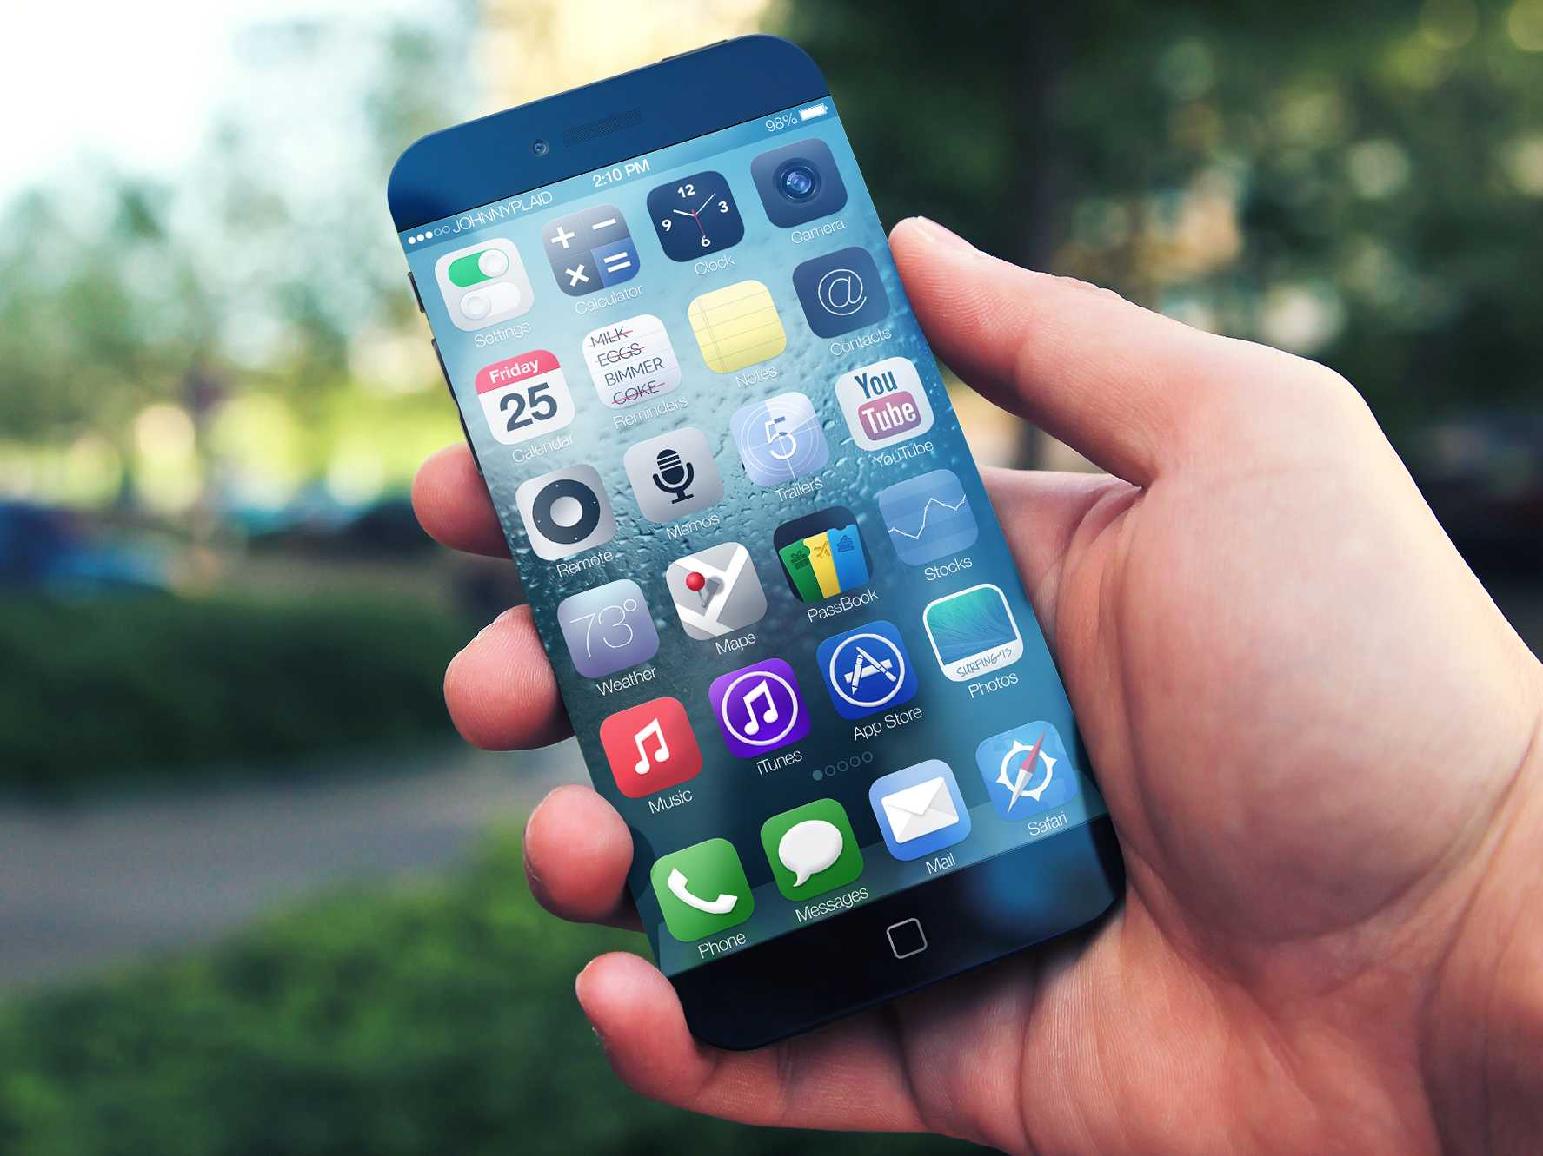
IPHONE

Slide 8
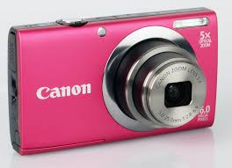
DIGITAL CAMERA

Slide 9
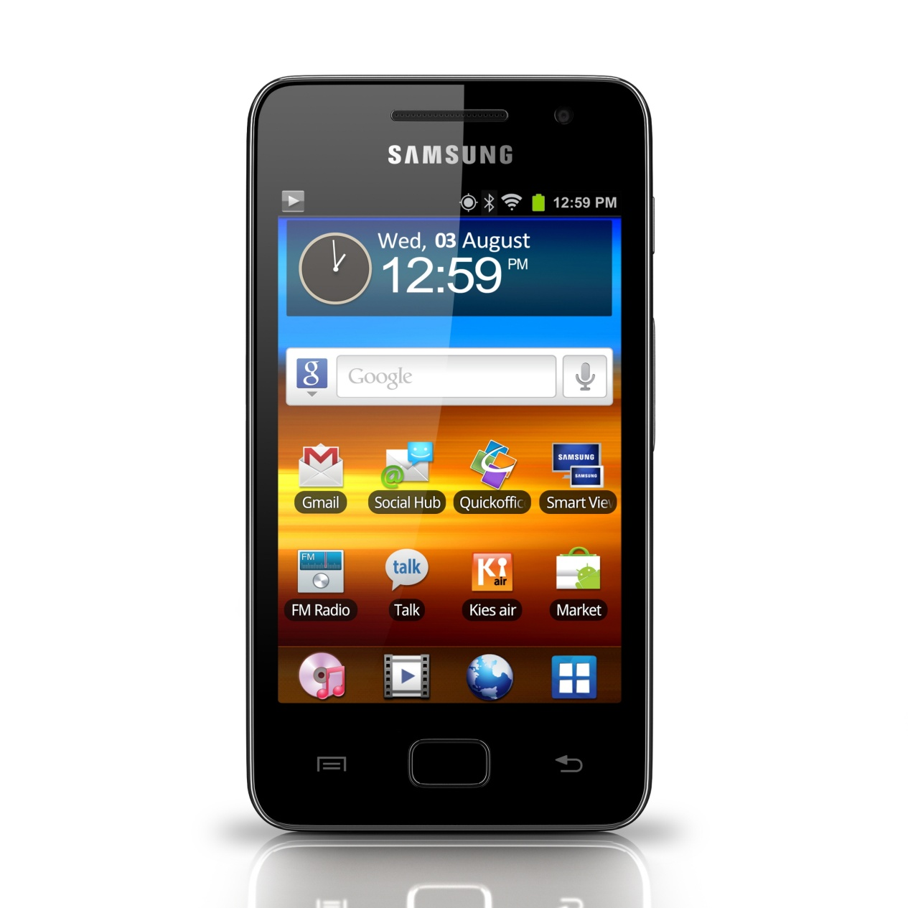
MOBILE PHONE

Slide 10
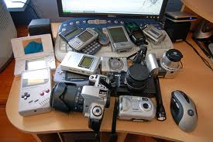
Which of these gadgets do you use and what for
LISTEN TO MUSIC TAKE PICTURES
SEND E–MAILS WATCH FILMS
SURF THE NET PLAY WITH IT
READ ELECTRONIC BOOKS
TALK TO FRIENDS AND FAMILY
SEND TEXT MESSAGES
STORE MUSIC FILES

Slide 11
Which things are the most or the least useful in the home from your point of view?
I believe …
To my mind....
If you ask me, I suppose that …
In my opinion …
I consider that a …is …
I feel that …is the most…
As for me I am concerned a …is
It’s obvious that my …is the thing №1 in my home…

