Slide 1
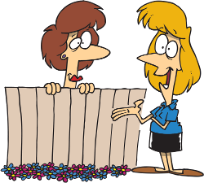
Reported Speech

Slide 2
Прямая речь –это речь, переданная дословно, без изменений.
He says to Lena, “I see my friends every day.”
He tells Lena that he sees his friends
every day.
Косвенная речь – это передача содержания прямой речи в форме пересказа.

Slide 3
He tells them, “I can help you.”
He tells them that he can help them.
При переводе прямой речи в косвенную
местоимения изменяются согласно
требованиям логики.

Slide 4
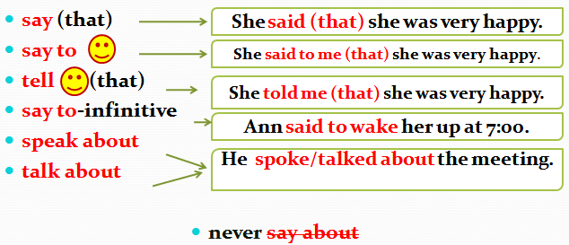
Reported Statements Глаголы, вводящие косвенную речь:

Slide 5
Reported Questions

Slide 6
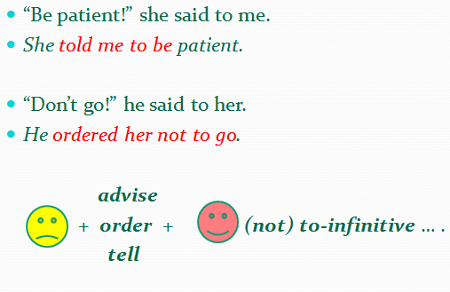
Reported Orders/Commands

Slide 7
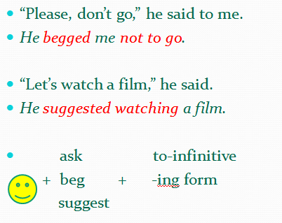
Reported Request/Suggestions

Slide 8
Direct speech | Reported speech
Present Simple Past Simple
“I want to learn Japanese”. | She said (that) she wanted to learn Japanese.
Present Continuous Past Continuous
“We are watching a film”. | They said (that) they were watching a film
Present Perfect Past Perfect
“I have brushed my teeth”. | She said (that) she had brushed her teeth.

Slide 9
Direct speech | Reported speech
Past Simple | Past Simple or Past Perfect
“I mowed the lawn”. | She said (that) she mowed/had mowed the lawn.
Present Perfect Continuous | Past Perfect Continuous
“He have been reading since morning”. | She said (that) she had been reading since morning.
Future Simple | Future in the Past
“I will meet you at 7:00”. | She said (that) she would meet me at 7:00

Slide 10
Остаются неизменными
Past Perfect/ Past Continuous
Не всегда надо изменять время глагола, когда
мы используем его в косвенной речи:
Если глагол, вводящий косвенную речь, стоит в Present или Future Tenses.
“I can’t speak French,” he says.
He says (that) he can’t speak French.
Если говорящий сообщает о какой-либо истине или состоянии.
“The sun sets in the west,” Mr. Thom said.
Mr. Thom said that the sun sets in the west.

Slide 12
MODAL VERBS IN REPORTED SPEECH
can | could
may | might
am/is/are to | was/were to
have to | had to
must | had to
should | should
need | needed

Slide 13
She said, "I live here."
She…

Slide 14
She said, "I live here."
She said that she lived there.

Slide 15
She said, "I am writing a letter now."
She…

Slide 16
She said, "I am writing a letter now."
She told me that she was writing a letter then.

Slide 17
She said, "I can't find your book."
She…

Slide 18
She said, "I can't find your book."
She said that she couldn't find my book.

Slide 19
Ann said :”Don’t close the door, please.”
Ann…

Slide 20
Ann said :”Don’t close the door, please.”
Ann asked not to close the door.

Slide 21
He asked:”When will they come?”
He…

Slide 22
He asked:”When will they come?”
He asked when they would come.

Slide 23
I said:” Come to my birthday party!”
I…

Slide 24
I said:” Come to my birthday party, Jane!”
I asked Jane to come to my birthday party.

Slide 25
She asked:”Did you buy this book?”
She…

Slide 26
She asked:”Did you buy this book?”
She asked me if I had bought that book.

