Slide 1
DAY AFTER DAY
Учитель английского языка
школы № 292 Фрунзенского р-на
Щербакова Юлия Сергеевна

Slide 2
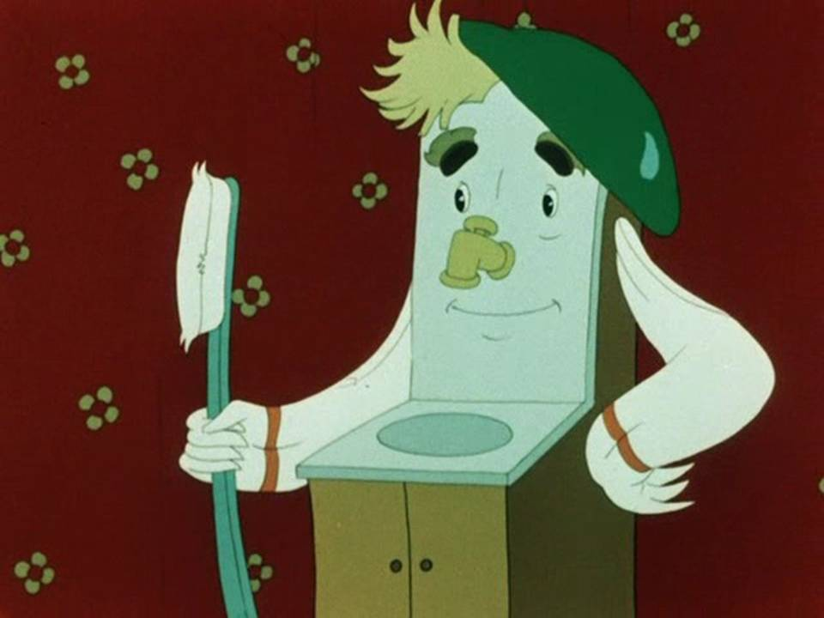
Brush teeth

Slide 3
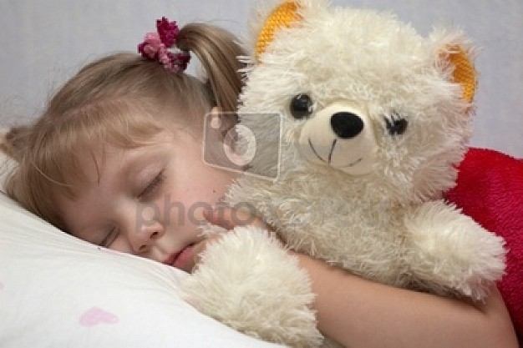
Go to bed.

Slide 4
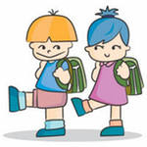
Go to school.

Slide 5
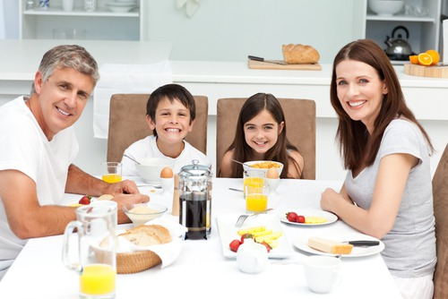
Have breakfast.

Slide 6
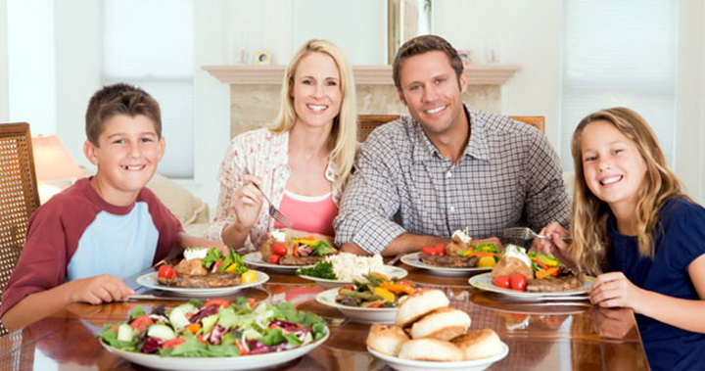
Have dinner.

Slide 7
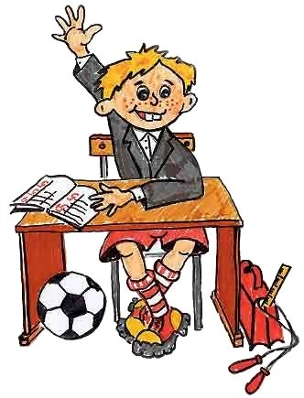
Have lessons at school.

Slide 8
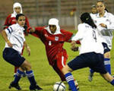
Play sports.

Slide 9
Questions:
1. Do you brush your teeth every morning?
Yes, I do / No, I do not.
2. Do you go to school every day?
Yes, I do/ No, I do not.
3. Do you play sports?
Yes, I do/ No, I do not.
4. Do you have breakfast every day?
Yes, I do/ No, I do not.

Slide 10
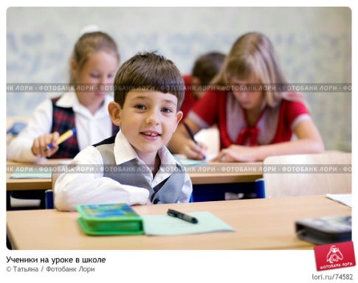
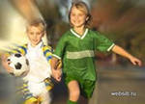
Match the pictures to the phrases:
1
1
4
A. Go to school.
B. Play sports.
C. Brush teeth.
D. Have lessons at school.
E. Go to bed.
F. Have breakfast.
2
5
3
6

Slide 11
Answer the questions:
Which of the activities do you do :
in the morning? In the afternoon? In the evening? At night? At weekends?
Which of them do not you do?

Slide 12
Present Simple.
Affirmative
I/you/we/they/ sleep
He/she/it sleeps
Negative
I/you/we/they/ do not sleep
He/she/it does not sleep
Interrogative
Do I/you/we/they sleep?
Does he/she/it sleep?

Slide 13
Form the third person singular.
goes
catches
1. I go – she…………. 5. I catch – she………
2. I sleep – he………. 6. I fix - he………
3. I study – she…….. 7. I wash – he…….
4. I play - she………. 8. I cry – he……
sleeps
fixes
studies
washes
plays
cries

Slide 14
Put the words in the correct order.
1. never/ Harry/ school/ walks/ to
2. Hermione/ studies/ always/ a lot
3. usually/ students/ free time/ their/ in common room/ the/ spend.
4. the/ Dursleys/ often/ Harry/ do not/ treat/ well
5. Hedwig/ brings/ sometimes/ Harry`s/ mail.

Slide 15
1. Harry never walks to school.
2. Hermione always studies a lot.
3. Students usually spend their free time in the common room.
4. The Dursleys do not often treat Harry well.
5. Hedwig sometimes brings Harrys mail.

Slide 16
Fill in with the correct form of the verbs.
1. What time……………………………(school/start)?
2. …………………………..(Harry/eat)frogs for lunch?
3. He………………(teach) History of magic.
4. He……………..(go) to school on foot.

