Slide 1
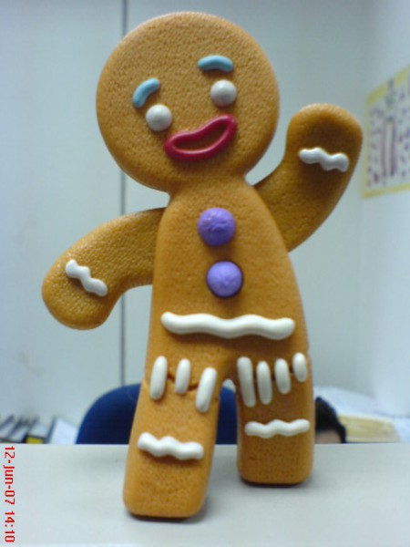
The Gingerbread Man Retell the story in past tenses, using reported speech

Slide 2
Characters
Дедушка (Grandpa) Бабушка (Granny) Пряничный человечек (Man) Кролик (Rabbit) Волк (Wolf) Медведь (Bear) Лиса (Fox)

Slide 3
Once upon a time. In the country house. Grandpa and Granny are talking.

Slide 4
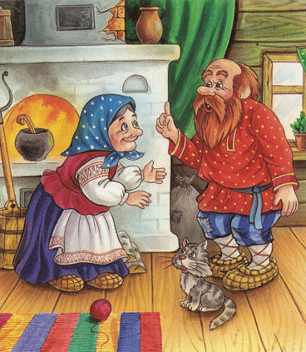
Grandpa: Oh, I'm hungry! Granny: I'll make a gingerbread man. Grandpa: Good idea!

Slide 5
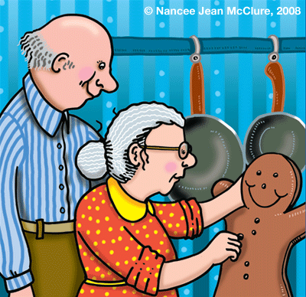
Granny comes and brings gingerbread man….

Slide 6
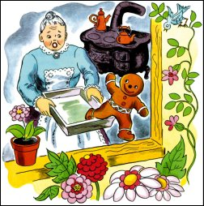
Granny: Here's the gingerbread man. Grandpa: Oh, it can run! Catch him!

Slide 7
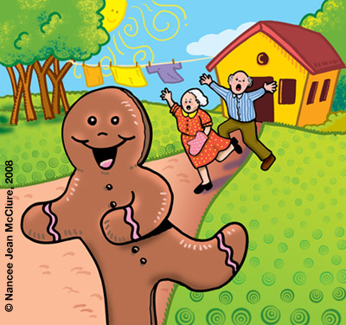
Man: Run, run, as fast as you can! You can't catch me, I'm the gingerbread man!

Slide 8
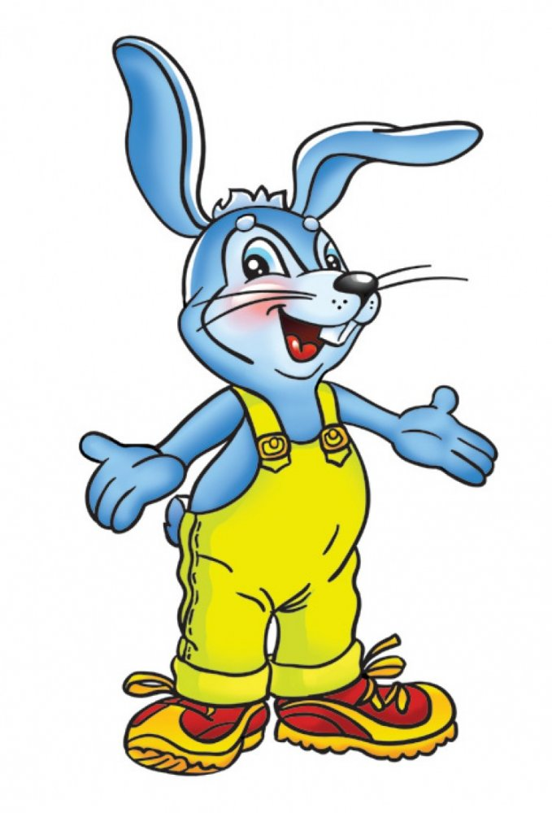
Gingerbread man runs away. Rabbit comes …

Slide 9
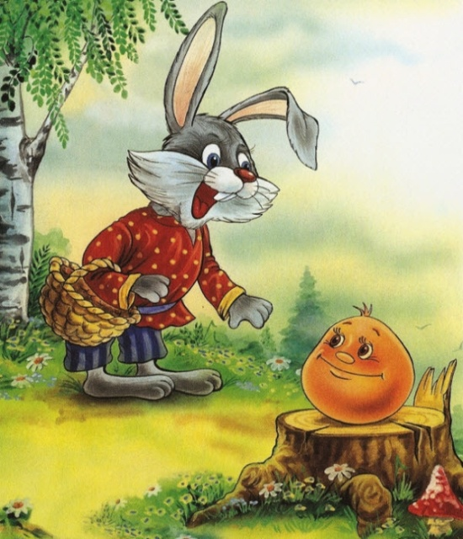
Grandpa: Hello, Rabbit! Rabbit: Hello! Can I help you? Granny: Yes! Can you catch the gingerbread man? Rabbit: All right, I'll try.
Man: Run, run, as fast as you can! You can't catch me, I'm the gingerbread man!

Slide 10
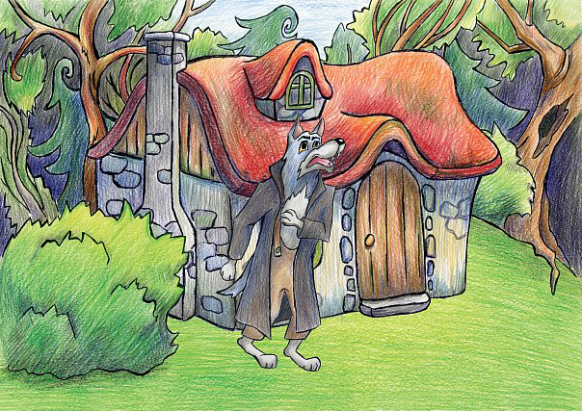
Gingerbread man runs away. Wolf comes …

Slide 11
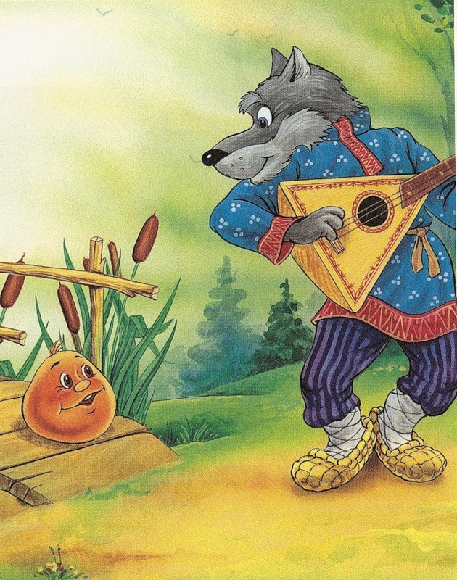
Grandpa: Hello, Wolf! Wolf: Hello! Can I help you? Granny: Yes! Can you catch the gingerbread man? Wolf: All right, I'll try.
Man: Run, run, as fast as you can! You can't catch me, I'm the gingerbread man!

Slide 12
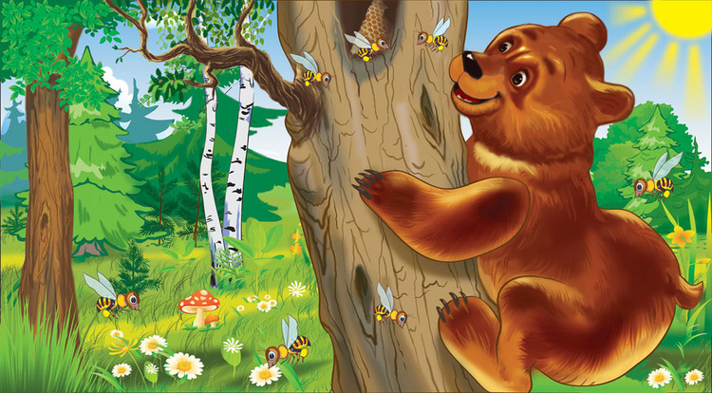
Gingerbread man runs away. Bear comes …

Slide 13
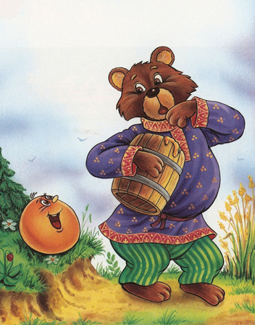
Grandpa: Hello, Bear! Bear: Hello! Can I help you? Granny: Yes! Can you catch the gingerbread man? Bear: All right, I'll try.
Man: Run, run, as fast as you can! You can't catch me, I'm the gingerbread man!

Slide 14
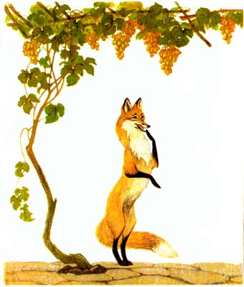
Gingerbread man runs away. Fox meets him …

Slide 15
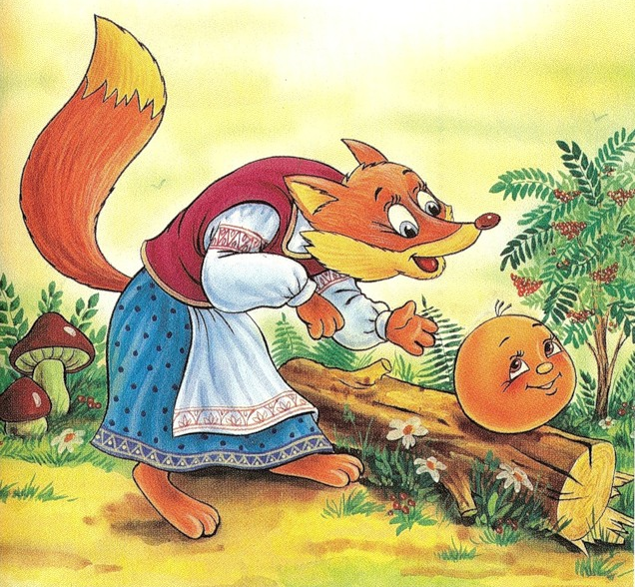
Fox: Hello, gingerbread man! Man: Run, run, as fast as you can! Fox: I'm sorry, I can't hear you. Can you come nearer, please?
Man: …You can't catch me, I'm the gingerbread man!

Slide 16
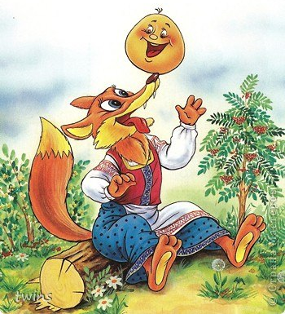
Fox: I'm sorry, I can't hear you. Can you come to my nose, please? Man: All right.
Fox: Now, can you say it again, please? Man: Run, run, as fast as you can! …
Fox eats gingerbread man.
Fox: Yes, it's a tasty gingerbread man!

Slide 17
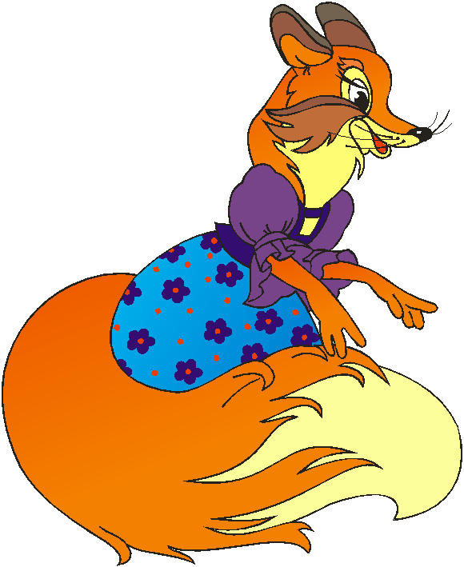
The End

