Slide 1
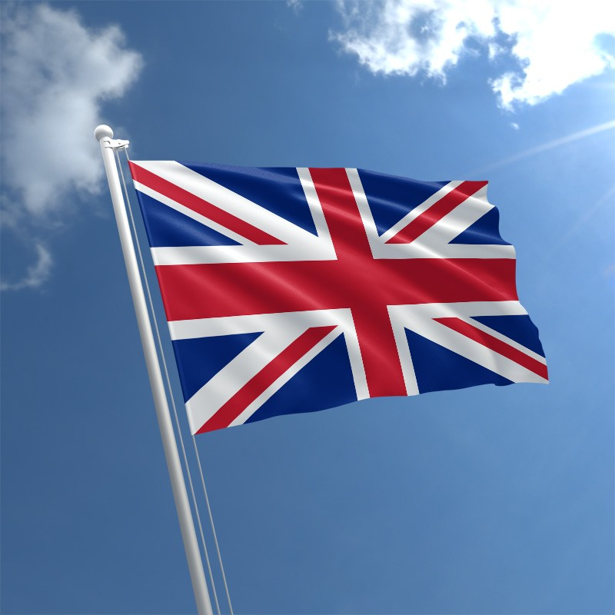
Great British
Sporting Events

Slide 2
Cambridge
Oxford
London
Ascot

Slide 3
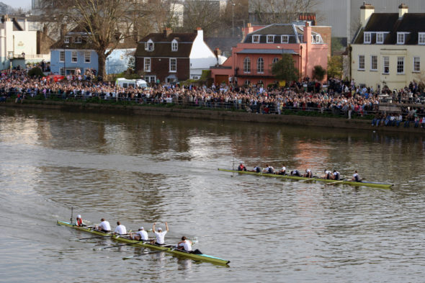
The Oxford and Cambridge Boat Race is a rowing race along the River Thames.
The competitors [kəm'petɪtəz] are students from Oxford and Cambridge universities.

Slide 4
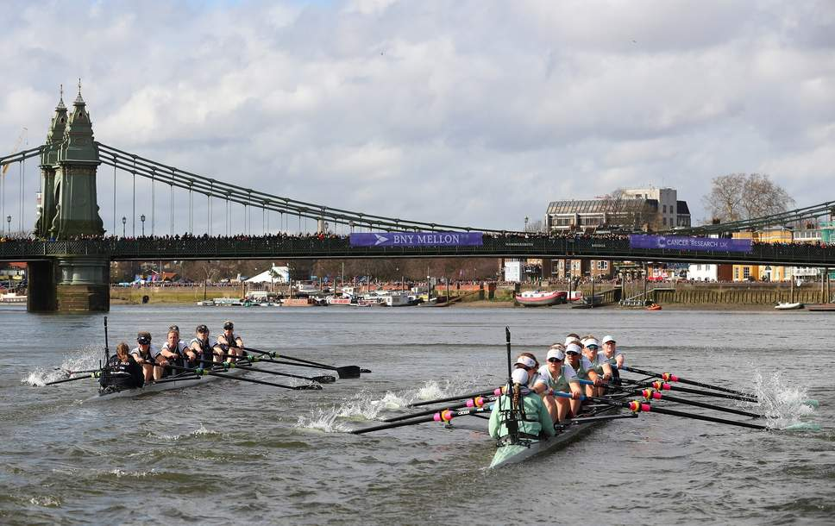
The men's race was first held in 1829, and the first women’s race took place in 1927 and has been held annually since 1964. Since 2015, the women's race has taken place on the same day.

Slide 5
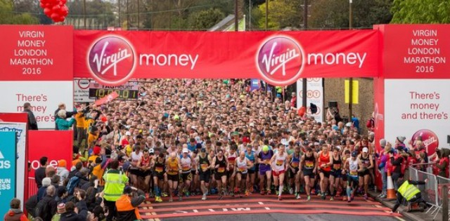
London Marathon is a serious athletic event which offers big prize money for the winners.
However, the majority [mə'ʤɔrətɪ] of runners do it for fun or to raise money for charity.

Slide 6
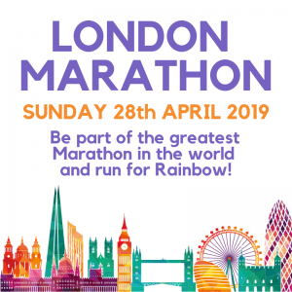
The race was founded by the former Olympic champion and journalist Chris Brasher and athlete John Disley.
It is one of the top six international marathons with the distance of 26 miles (about 42km).

Slide 7
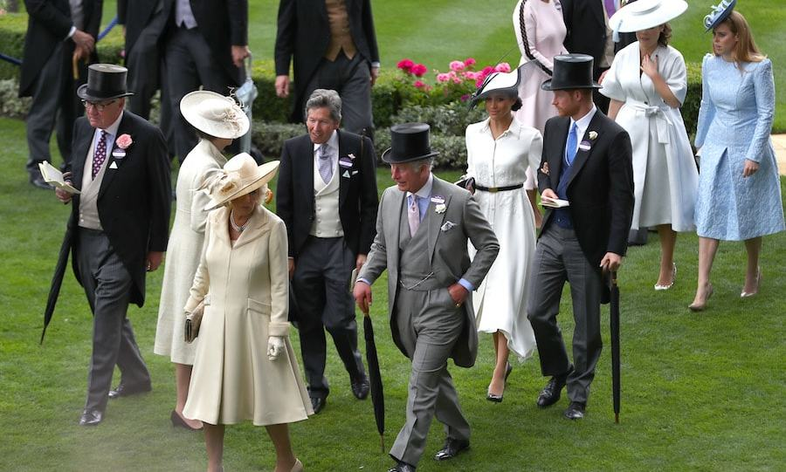
Royal Ascot is a horse racing event which is very popular with members of the royal family.

Slide 8
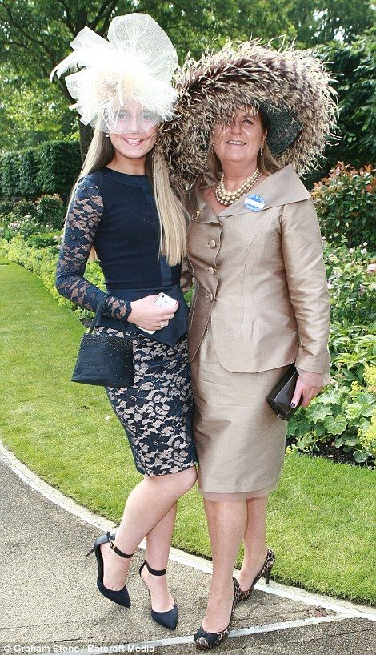
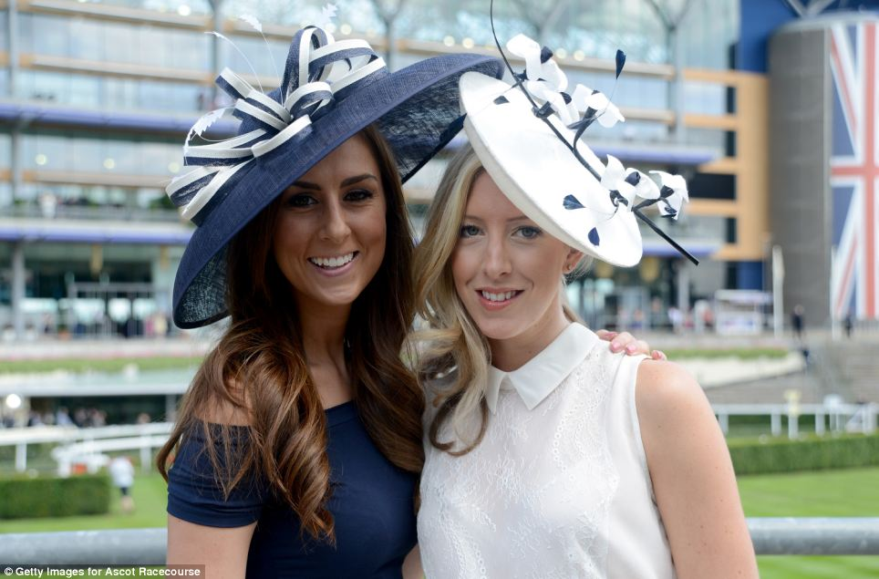
TV presenters love to comment on what everyone’s wearing, especially the ladies’ smart hats.

Slide 9
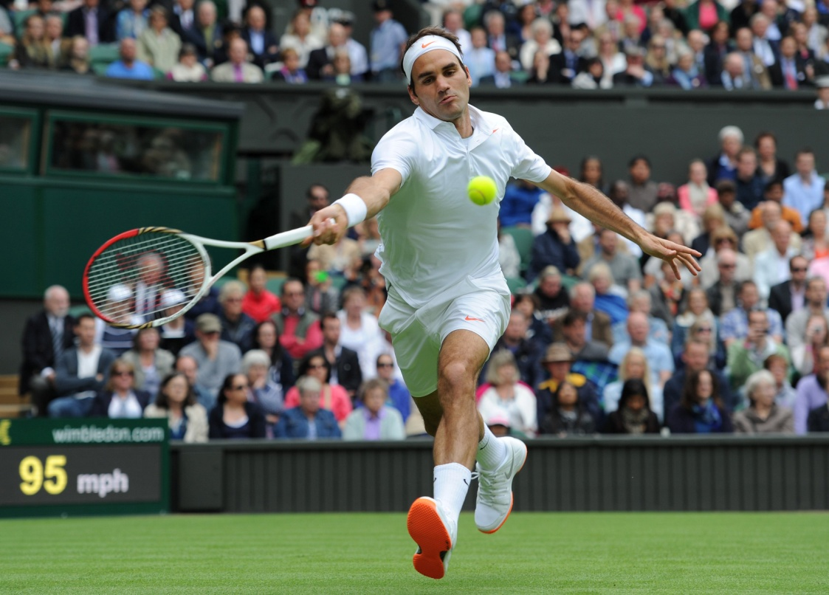
Wimbledon is the world’s oldest and most famous tennis championship.
The tournament ['tuənəmənt] traditionally lasts for over two weeks in late June and early July.

Slide 10
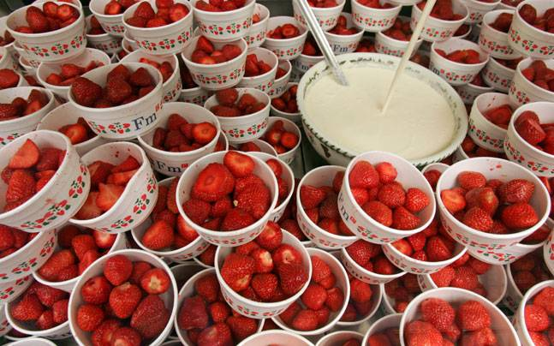
Strawberries and cream are the traditional snack at Wimbledon.
28,000 kilos of strawberries are sold every year.

